Slide 1

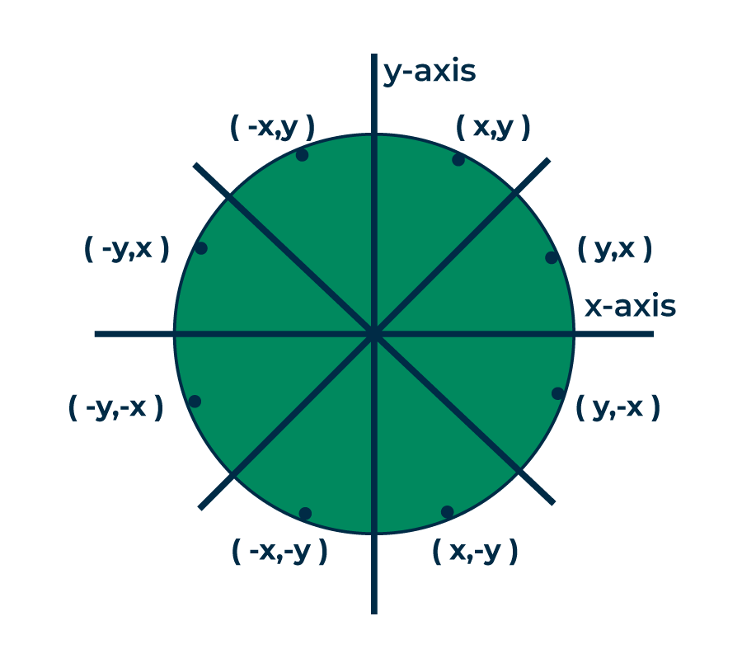
Lecture 5 Mid Point Circle Drawing Algorithm
Prepared by Tapasy Rabeya Senior Lecturer CSE, DIU | Updated by Nushrat Jahan Oyshi Lecturer CSE, DIU

Slide 2
Output Primitives
Output Primitives: Basic geometric structures (points, straight line segment, circles and other conic sections, quadric surfaces, spline curve and surfaces, polygon color areas, and character strings)
These picture components are often defined in a continuous space.
In order to draw the primitive objects, one has to first scan convert the object.
Scan convert: Refers to be operation of finding out the location of pixels to the intensified and then setting the values of corresponding bits, in the graphic memory, to the desired intensity code.

Slide 3
Output Primitives
Each pixel on the display surface has a finite size depending on the screen resolution and hence a pixel cannot represent a single mathematical point.

Slide 4
Circle Drawing Algorithm
Circles and ellipses are common components in many pictures.
Circle generation routines are often included in packages.

Slide 5
Circle Equation
Polar form
x = rCosθ
y = rSinθ
(r = radius of circle)
y
P=(rCosθ, rSinθ)
r
θ
rSinθ
x
rCosθ

Slide 6
Circle Drawing Algorithm
θ = 0°
while (θ < 360°)
x = rCosθ, y = rSinθ
setPixel(x,y)
θ = θ + 1° end while
Disadvantages
To find a complete circle θ varies from 0° to 360°
The calculation of trigonometric functions is very slow.

Slide 7

Cartesian form
Use Pythagoras theorem
x² + y² = r²
So, we can write a simple circle drawing algorithm by solving the equation for y at unit x intervals using:
r
y
y
x
r
y
y = ± r ² − x²
x
x
Disadvantages
The calculation of complex mathematical functions makes the process very slow.

Slide 8

Circle Drawing Algorithm
Step through x-axis to determine y-values

Slide 9
Circle Drawing Algorithm
However, unsurprisingly this is not a brilliant solution!
Firstly, the resulting circle has large gaps where the slope approaches the vertical
Secondly, the calculations are not very efficient
The square (multiply) operations
The square root operation – try really hard to avoid these!
We need a more efficient, more accurate solution

Slide 10
Circle Drawing Algorithm
Similarly to the case with lines, there is an incremental algorithm for drawing circles – the mid-point circle algorithm
In the mid-point circle algorithm we use eight-way symmetry
so only ever calculate the points for the top right eighth of a circle, and then use symmetry to get the rest of the points

Slide 11
Mid Point Circle Drawing Algorithm
Use 8-fold symmetry and only compute pixel positions for the 45° sector.
The first thing we can notice to make our circle drawing algorithm more efficient is that circles centered at (0, 0) have eight-way symmetry
(-x, y) (x, y)
(-y, x)
(y, x)
R
(-y, -x)
2
(y, -x)
(-x, -y)
(x, -y)

Slide 12
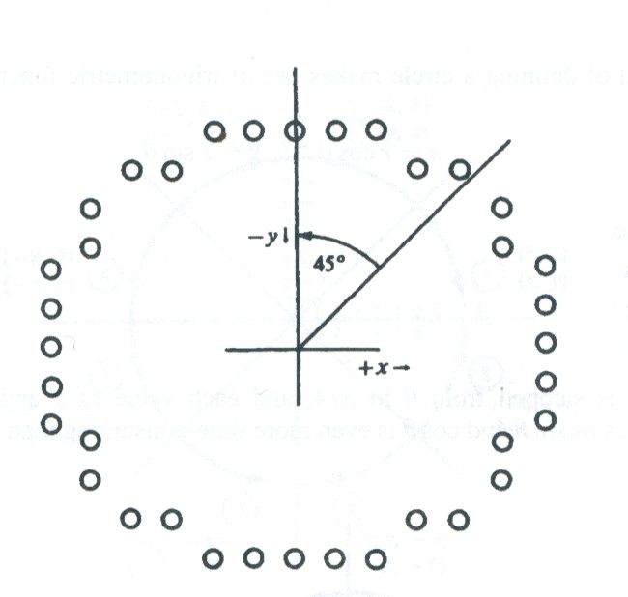
Mid Point Circle Drawing Algorithm
Points are generated from 90º to 45º, moves will be made only in the +x and –y direction.
positive x direction over this octant and use a decision parameter

Slide 13
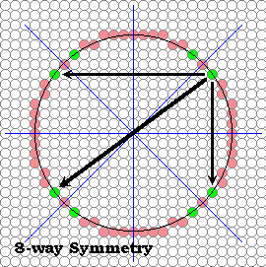
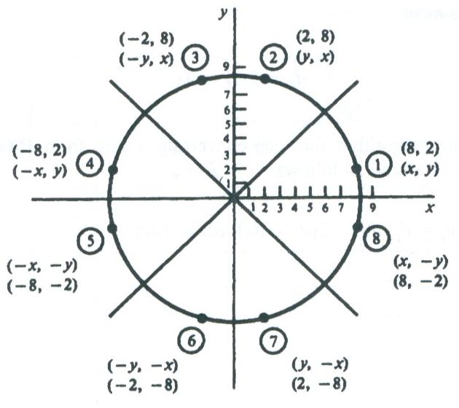
Mid Point Circle Drawing Algorithm
considering the symmetry of circles
8 -Way symmetry

Slide 14
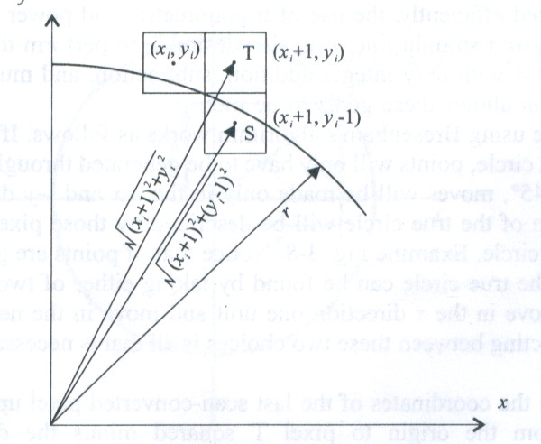
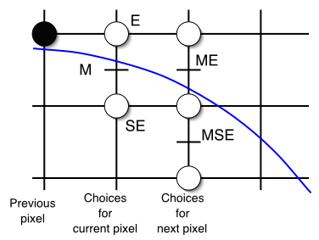
Mid Point Circle Drawing Algorithm
As in the line algorithm, we sample at unit intervals and determine the closet pixel position to the circle path at each step.

Slide 15
Mid Point Circle Drawing Algorithm
Let’s re-jig the equation of the circle slightly give us:
f (x, y) = x² + y² − r²
circle
The equation evaluates as follows:
< 0, if(x, y) is inside the circle boundary
f_{circle} (x, y) = 0, if (x, y) is on the circle boundary > 0, if (x, y) is outside the circle boundary
By evaluating this function at the midpoint between the candidate pixels we can make our decision

Slide 16
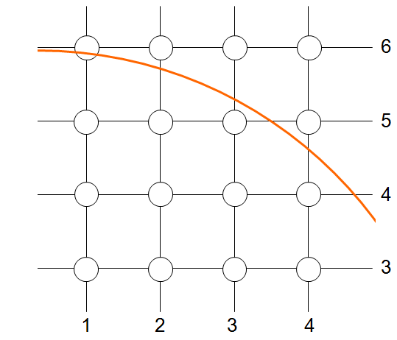
Mid Point Circle Drawing Algorithm

Slide 17
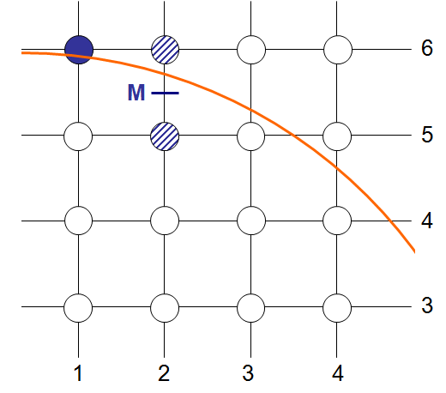
Mid Point Circle Drawing Algorithm

Slide 18
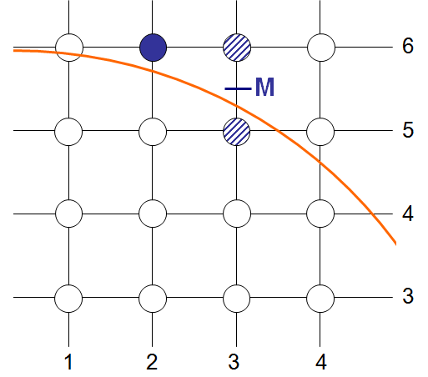
Mid Point Circle Drawing Algorithm

Slide 19

Mid Point Circle Drawing Algorithm
If P_{k}​<0 is negative, the midpoint is inside the pixel, and we choose pixel T.
If P_{k}>0, we choose pixel S.

Slide 20
Mid Point Circle Drawing Algorithm
• If T is chosen (P_{k} < 0), then yₖ₊₁ = yₖ • If pixel S is chosen (P_{k} > 0), then yₖ₊₁ = yₖ − 1

Slide 21



Mid Point Circle Drawing Algorithm
Initial value for the decision parameter using the original function of (0,r)
When r is an integer we can simply set

Slide 22
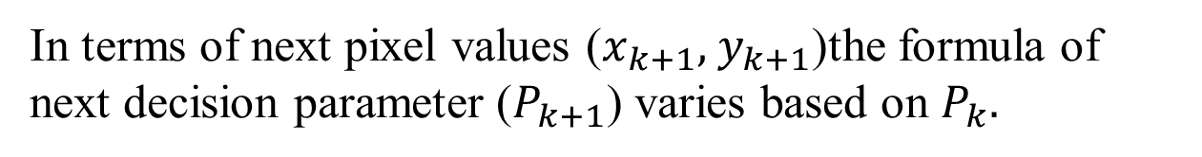
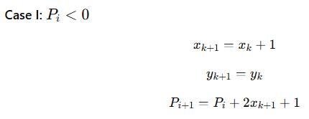
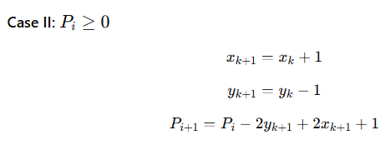
Mid Point Circle Drawing Algorithm

Slide 23
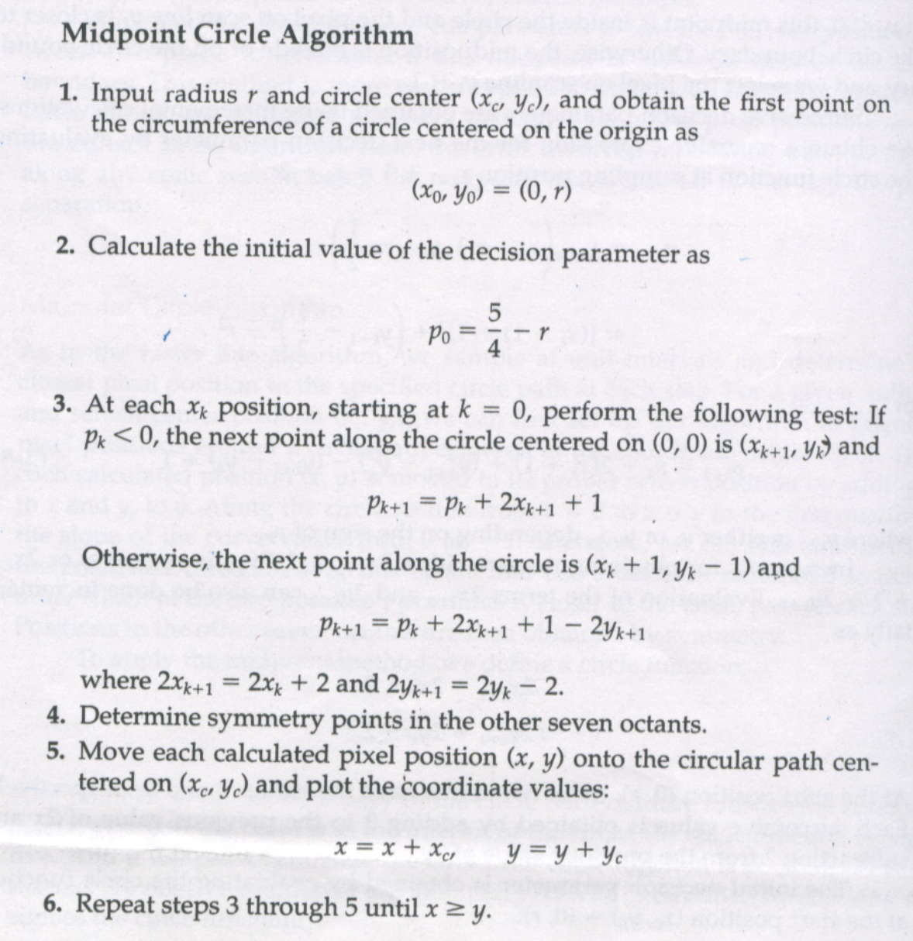
Mid Point Circle Drawing Algorithm

Slide 24
Derivation: Mid Point Circle Drawing Algorithm
External Resource:
https://getsetcg.blogspot.com/2018/10/mid-point-circle-drawing-derivation.html
Topics to Study:
1. Derivation of Mid point circle drawing algorithm
2. Derivation for P_{k} > 0 and P_{k} < 0
3. Derivation of the formula for P₀

Slide 25
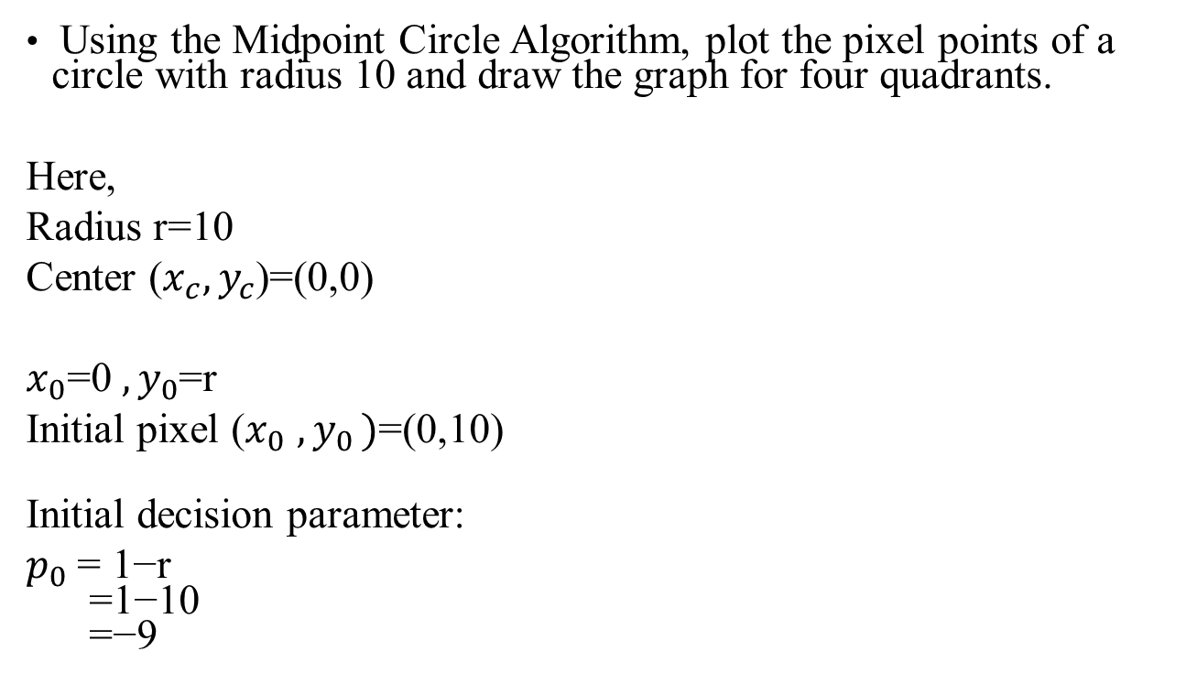
Example

Slide 26
Example
Midpoint Circle Algorithm Table (r = 10)
Stop condition: x≥y
Step | (x) | (y) | (p_k) | Q-I (+x,+y) | Q-II (−x,+y) | Q-III (−x,−y) | Q-IV (+x,−y)
0 | 0 | 10 | −9 | (0,10) | (0,10) | (0,−10) | (0,−10)
1 | 1 | 10 | −6 | (1,10) | (−1,10) | (−1,−10) | (1,−10)
2 | 2 | 10 | −1 | (2,10) | (−2,10) | (−2,−10) | (2,−10)
3 | 3 | 10 | 6 | (3,10) | (−3,10) | (−3,−10) | (3,−10)
4 | 4 | 9 | −3 | (4,9) | (−4,9) | (−4,−9) | (4,−9)
5 | 5 | 9 | 8 | (5,9) | (−5,9) | (−5,−9) | (5,−9)
6 | 6 | 8 | 5 | (6,8) | (−6,8) | (−6,−8) | (6,−8)
7 | 7 | 7 | 6 | (7,7)
Stop at (7,7) and no need to include this point (7,7) This table has all the points for Octant-1

Slide 27
Example
Now generate point for Octant-2 by reversing the points from Octant-1.
Octant-1 |  |  |  | Octant-2
Q-I (+x,+y) | Q-II (−x,+y) | Q-III (−x,−y) | Q-IV (+x,−y) | Q-I (+x,+y) | Q-II (−x,+y) | Q-III (−x,−y) | Q-IV (+x,−y)
(0,10) | (0,10) | (0,−10) | (0,−10) | (10,0) | (-10,0) | (-10,0) | (10,0)
(1,10) | (−1,10) | (−1,−10) | (1,−10) | (10,1) | (-10,1) | (-10,-1) | (10,-1)
(2,10) | (−2,10) | (−2,−10) | (2,−10) | (10,2) | (−10,2) | (−10,-2) | (10,-2)
(3,10) | (−3,10) | (−3,−10) | (3,−10) | (10,3) | (−10,3) | (−10,-3) | (10,-3)
(4,9) | (−4,9) | (−4,−9) | (4,−9) | (9,4) | (−9,4) | (−9,-4) | (9,-4)
(5,9) | (−5,9) | (−5,−9) | (5,−9) | (9,5) | (−9,5) | (−9,-5) | (9,-5)
(6,8) | (−6,8) | (−6,−8) | (6,−8) | (8,6) | (−8,6) | (−8,-6) | (8,-6)
This table includes all the points of the given circle.

Slide 28
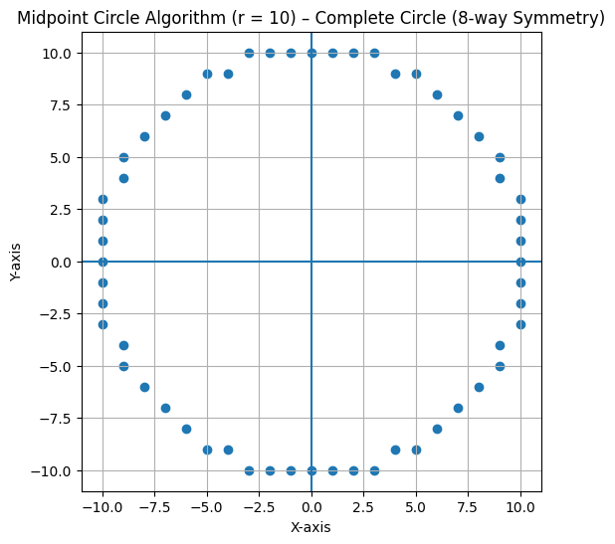
Example

